Slide 1

Customer Shopping Behavior Analysis
Uncovering insights from 3,900 transactions across product categories to guide strategic business decisions.

Slide 2
Dataset at a Glance
3,900
18
Purchases
Features
$59.76
3.75
Avg. Spend
Avg. Rating
Demographics
Purchase Details
Behavior
Age, Gender, Location, Subscription
Category, Amount, Season, Size, Color
Discounts, Frequency, Ratings, Shipping

Slide 3

Data Preparation in Python
01
Load & Explore
Imported with pandas; used df.info() and .describe()
02
Clean & Impute
Filled 37 missing Review Ratings with category median
03
Feature Engineering
Created age_group and purchase_frequency_days columns
04
Load to PostgreSQL
Cleaned DataFrame exported to database for SQL analysis

Slide 4
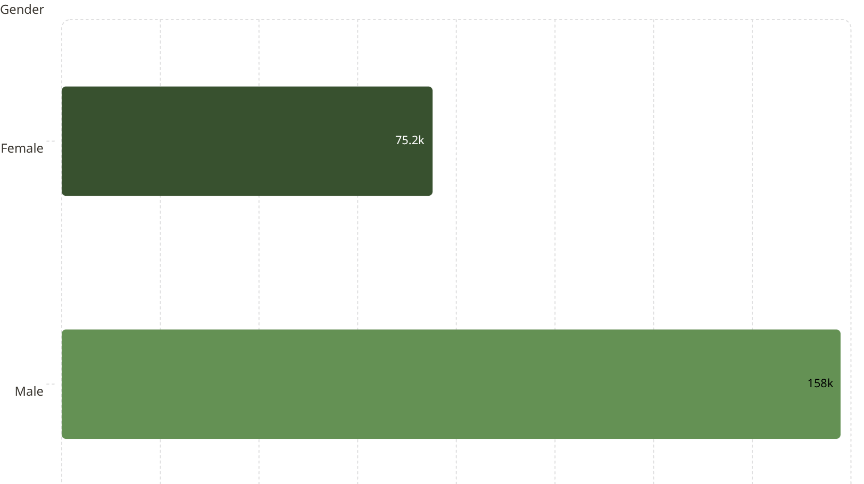
Revenue by Gender & Shipping
Shipping Type vs. Avg. Spend
Standard
Express
$58.46 avg. purchase
$60.48 avg. purchase
Express shipping users spend ~$2 more per transaction.

Slide 5
Top Products by Rating & Discount
Highest Rated
Most Discount-Dependent
Product
Rating
Product
Discount Rate
Gloves
3.86
Hat
50.00%
Sandals
3.84
Sneakers
49.66%
Boots
3.82
Coat
49.07%
Hat
3.80
Sweater
48.17%
Skirt
3.78
Pants
47.37%

Slide 6
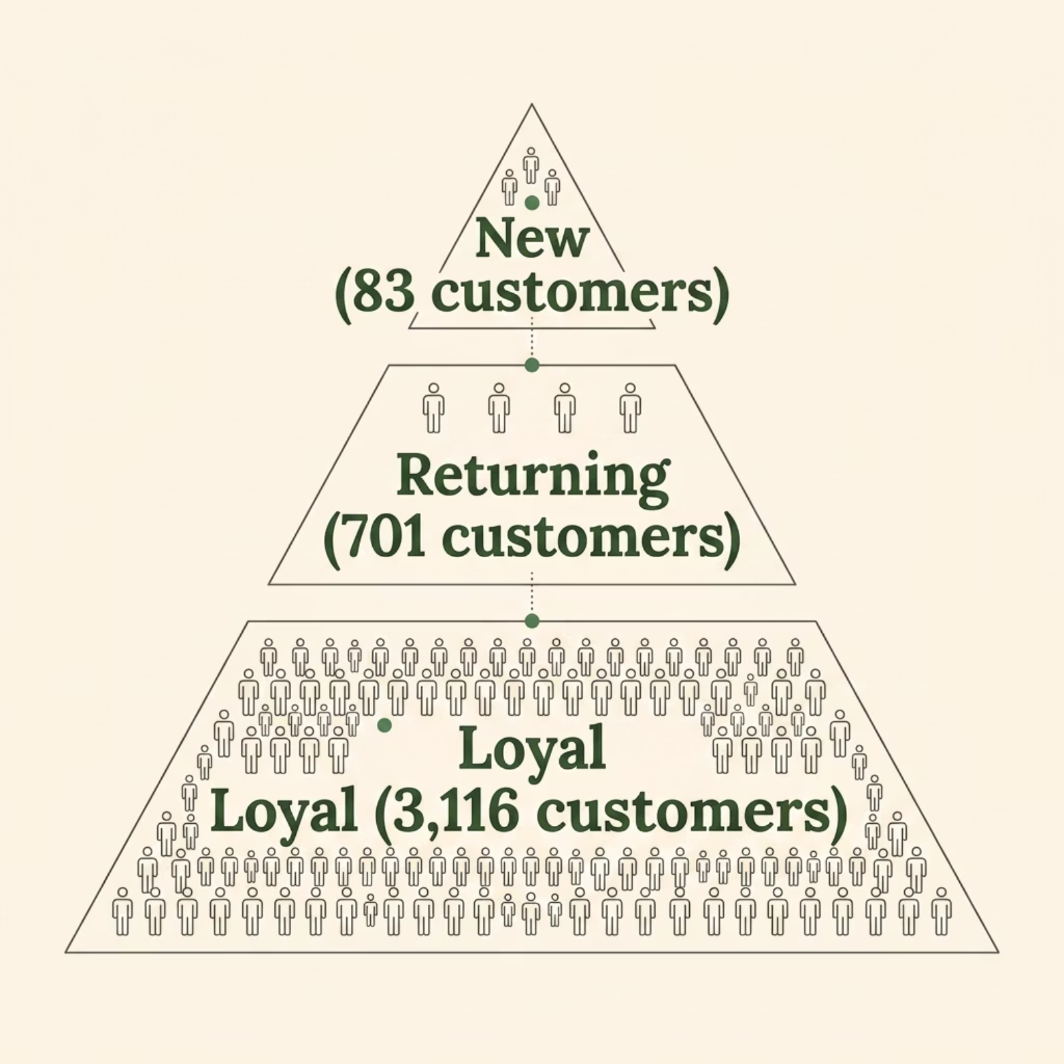

Customer Segmentation
Segment Breakdown
Loyal
Returning
3,116 customers
701 customers
New
83 customers
Repeat buyers (>5 purchases): 958 subscribed vs. 2,518 non-subscribed.

Slide 7



Subscribers vs. Non-Subscribers
27%
73%
Subscribers
Non-Subscribers
1,053 customers · $62,645 total revenue
2,847 customers · $170,436 total revenue
Avg. spend is nearly identical — subscribers $59.49 vs. non-subscribers $59.87. Subscription growth is a key opportunity.

Slide 8
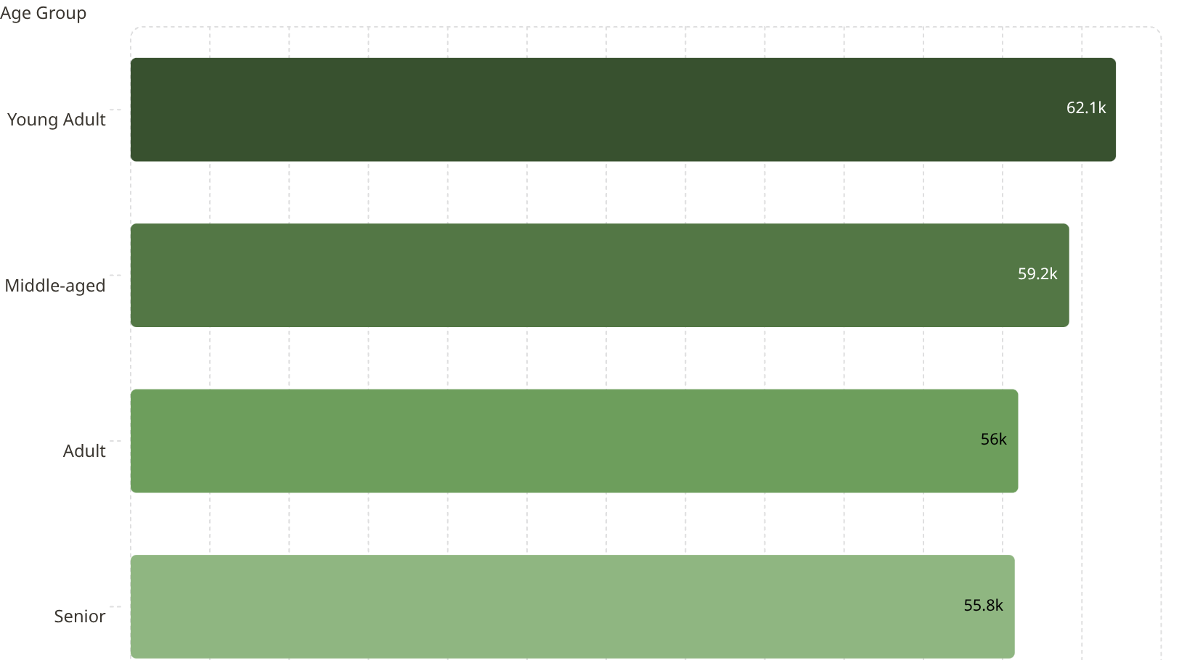
Revenue by Age Group
Top Categories by Orders
Category
#1 Product
#2 Product
Clothing
Blouse (171)
Pants (171)
Accessories
Jewelry (171)
Sunglasses (161)
Footwear
Sandals (160)
Shoes (150)
Outerwear
Jacket (163)
Coat (161)

Slide 9
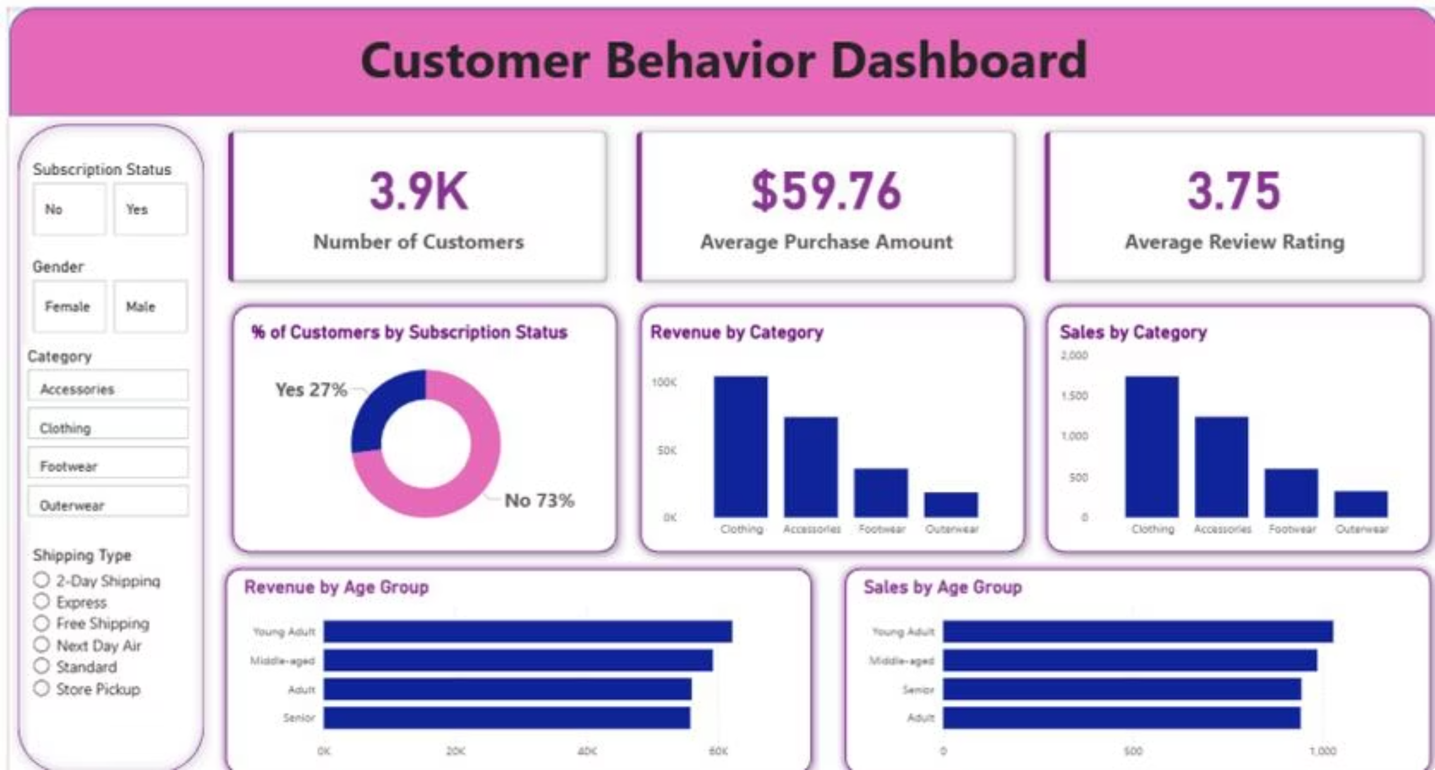
Power BI Dashboard
Interactive dashboard with filters for Subscription Status, Gender, Category, and Shipping Type — enabling drill-down across all key metrics.

Slide 10

Business Recommendations
Boost Subscriptions
Loyalty Programs
Review Discount Policy
Promote exclusive subscriber benefits
Reward repeat buyers to grow the Loyal segment
Balance sales boosts with margin control
Targeted Marketing
Product Positioning
Focus on Young Adults and Express-shipping users
Highlight top-rated items in campaigns

